Slide 1

Welcome to
our class 5A
Teacher: Ngo Thi Bich Loan
Binh Hai No.1 Primary School

Slide 2




01
Warm-up and Review

Slide 3






Project
Presentation
Class: 5A

Slide 4


Work
in groups.

Slide 5
Let’s talk
in the front!

Slide 6






Slide 7
Thursday, March 09th ,2026
Unit 15: OUR HEALTH
Lesson 1(1,2,3)

Slide 8
Vocabulary:
-feel: cảm thấy
-matter: vấn đề
-headache: bệnh đau đầu
-toΤhache: bệnh đau răng
-sore thrΞt: bệnh viêm họng
-stomach ache: bệnh đau bụng

Slide 9
02
Activity 1
Look, listen and repeat.

Slide 10

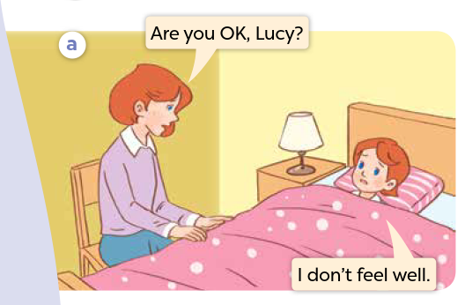


Look and say.

Slide 11
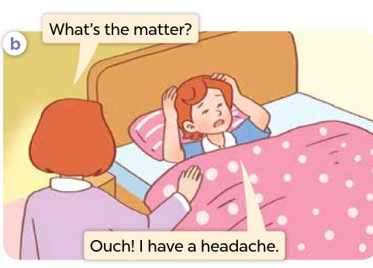
Look and say.

Slide 12
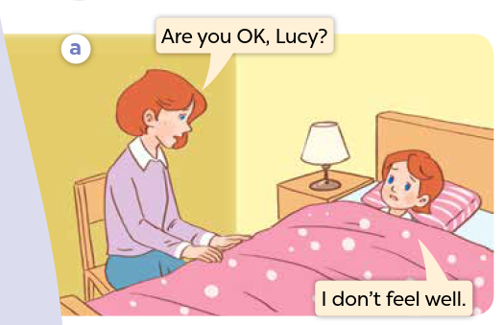

Listen and point.

Slide 13
Listen, point and repeat.

Slide 14
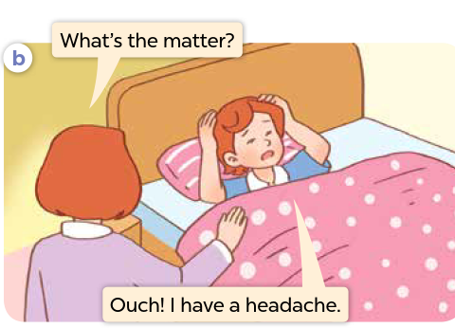
Listen, point and repeat.

Slide 15
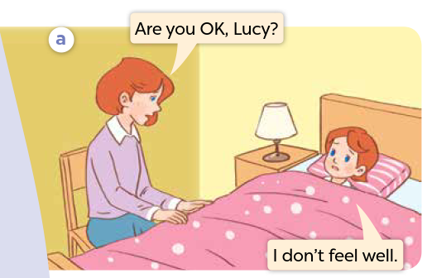
Listen and repeat.

Slide 16
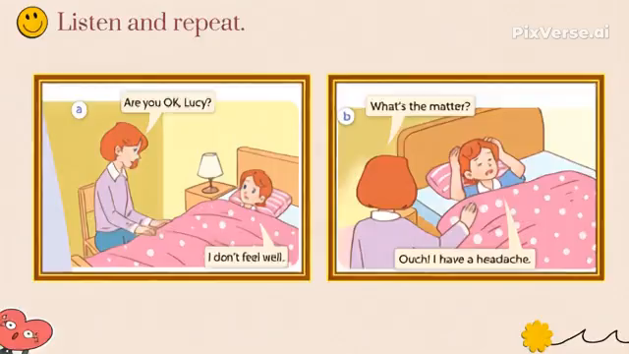

Slide 18
03
Activity 2
Listen, point and say.

Slide 19
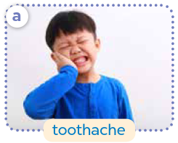
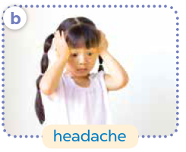
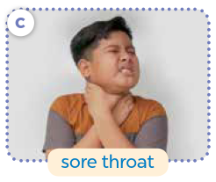
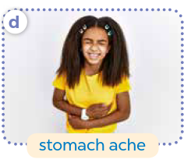
Look and say.

Slide 20
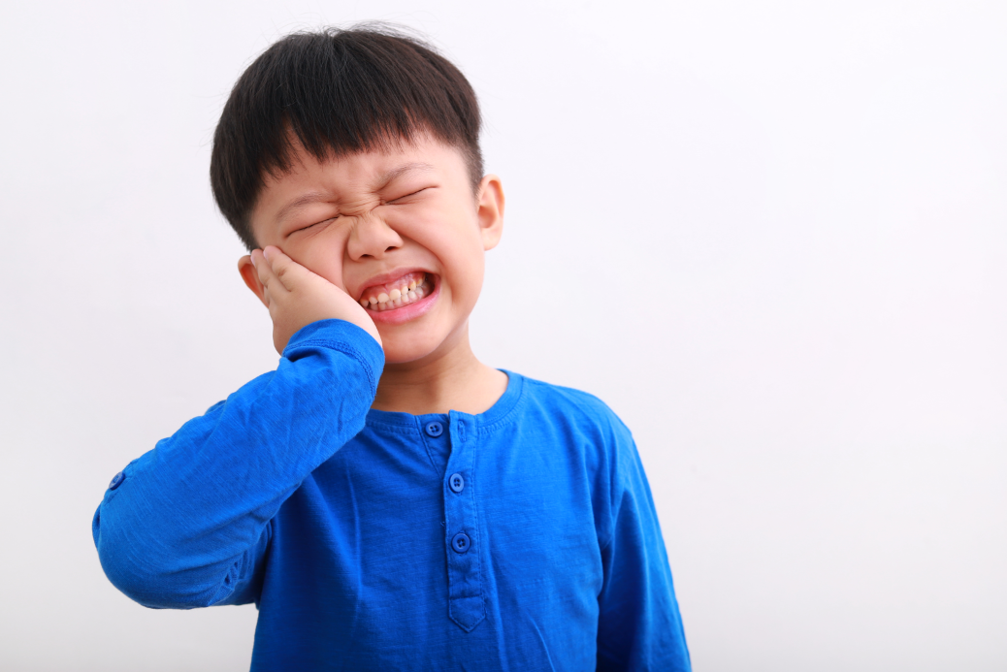
Listen and repeat.
a. toothache

Slide 21
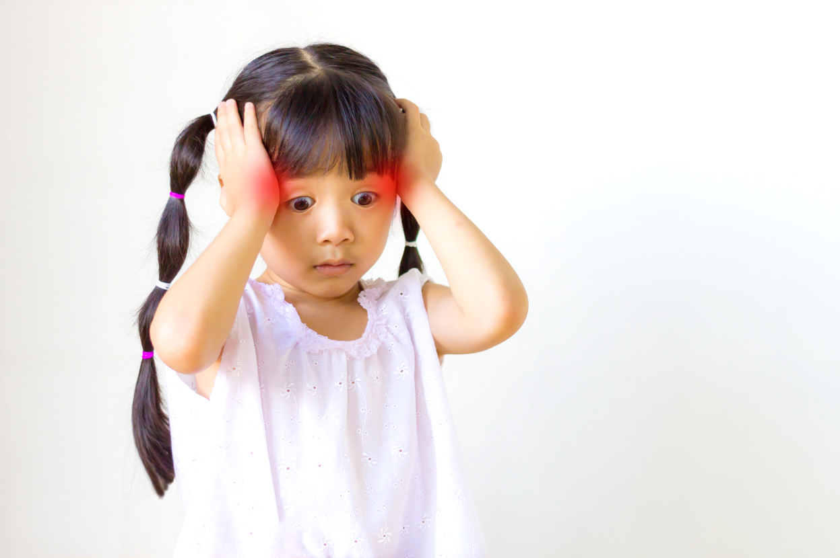
Listen and repeat.
b. headache

Slide 22
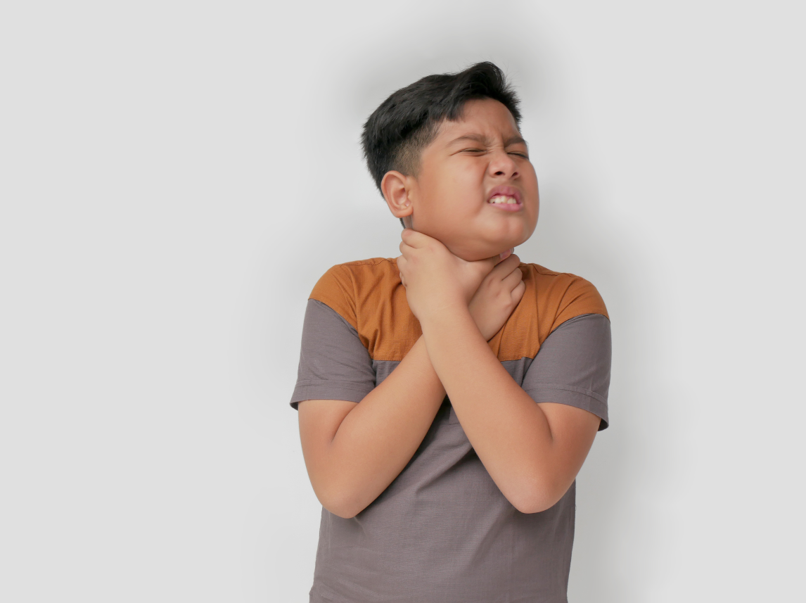
Listen and repeat.
c. sore throat

Slide 23
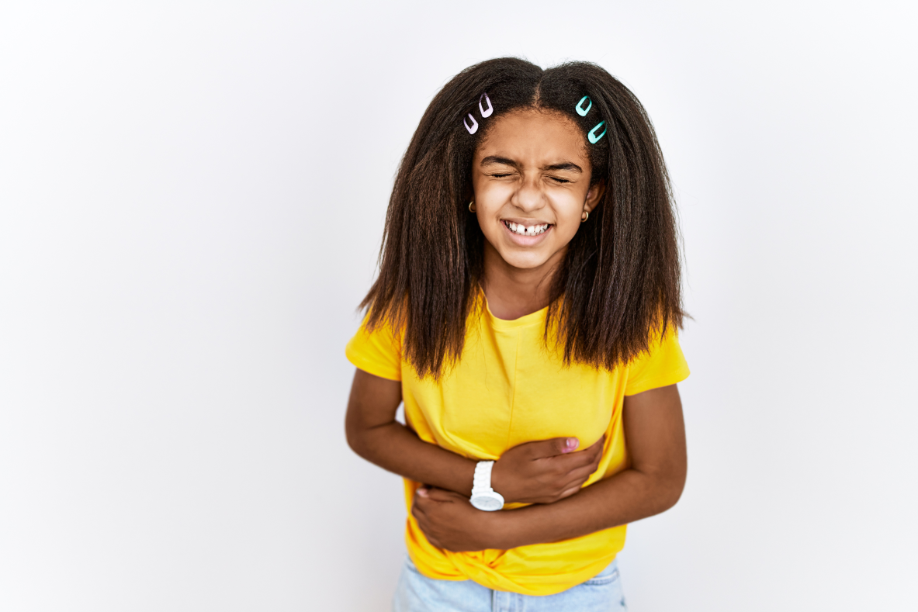
Listen and repeat.
d. stomach ache

Slide 24
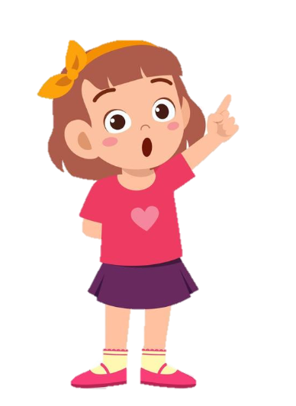
Listen and repeat.
I have a toothache.
What’s the matter?

Slide 25
Listen and repeat.
I have a headache.
What’s the matter?

Slide 26
Listen and repeat.
I have a sore throat.
What’s the matter?

Slide 27
Listen and repeat.
I have a stomach ache.
What’s the matter?

Slide 28
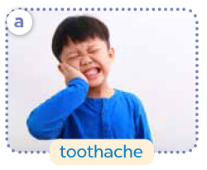


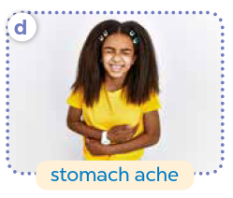
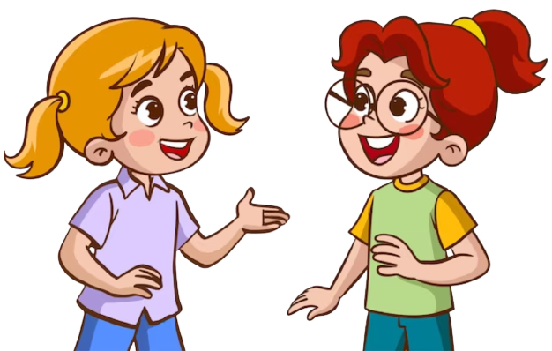
Ask and answer.

Slide 30
04
Activity 3
Let’s talk.

Slide 31

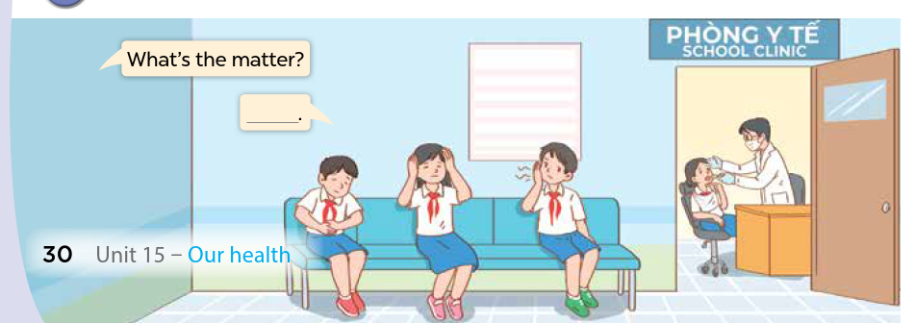

Look and say.

Slide 32

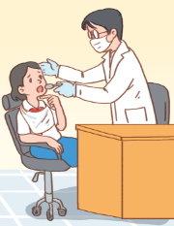
Look and say.
________________
What’s the matter?

Slide 33
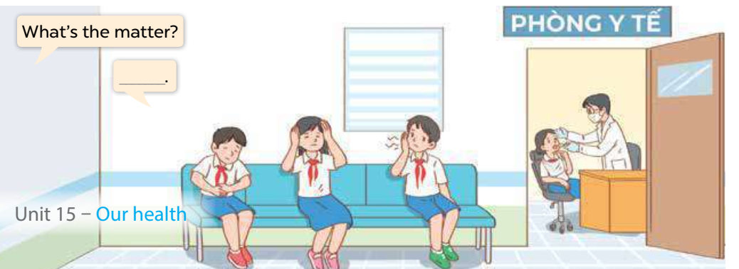
Ask and answer.

Slide 34

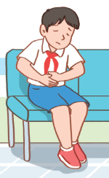

Ask and answer.
What’s the matter?
I have
a stomach ache.

Slide 35
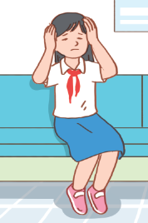
Look and say.
What’s the matter?
I have a headache.

Slide 36
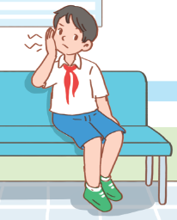
Look and say.
What’s the matter?
I have a toothache.

Slide 37
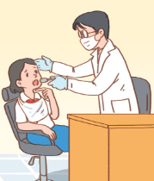
Look and say.
What’s the matter?
I have
a sore throat.

Slide 39
05
Fun corner and Wrap-up

Slide 40
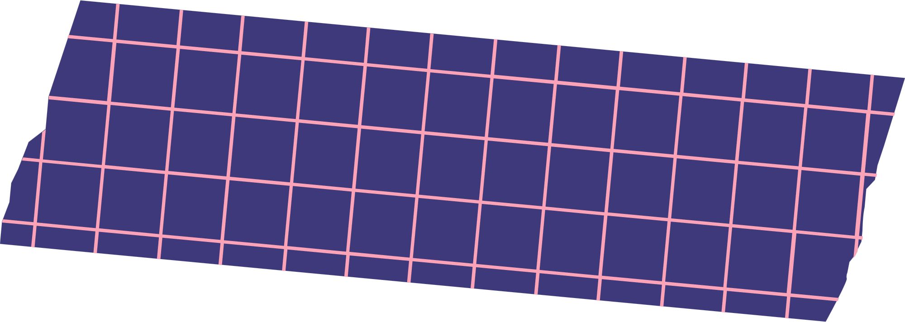




Yes or No Game
Let’s play!

Slide 41
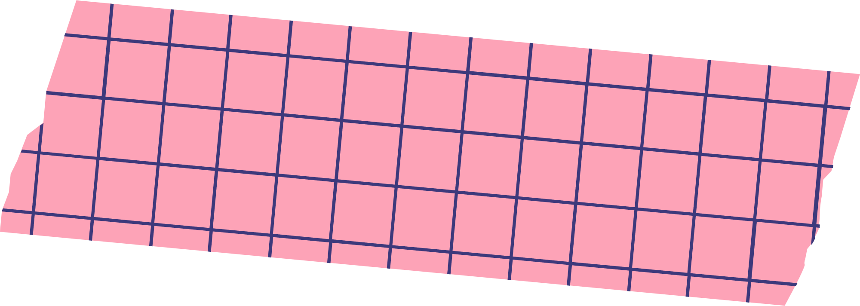


The
Rules
  Answer the questions within limit time.
  If the answer is correct, the player will get 1 point.
  If the answer is wrong, the player will lose 1 point.
  Have fun!

Slide 42

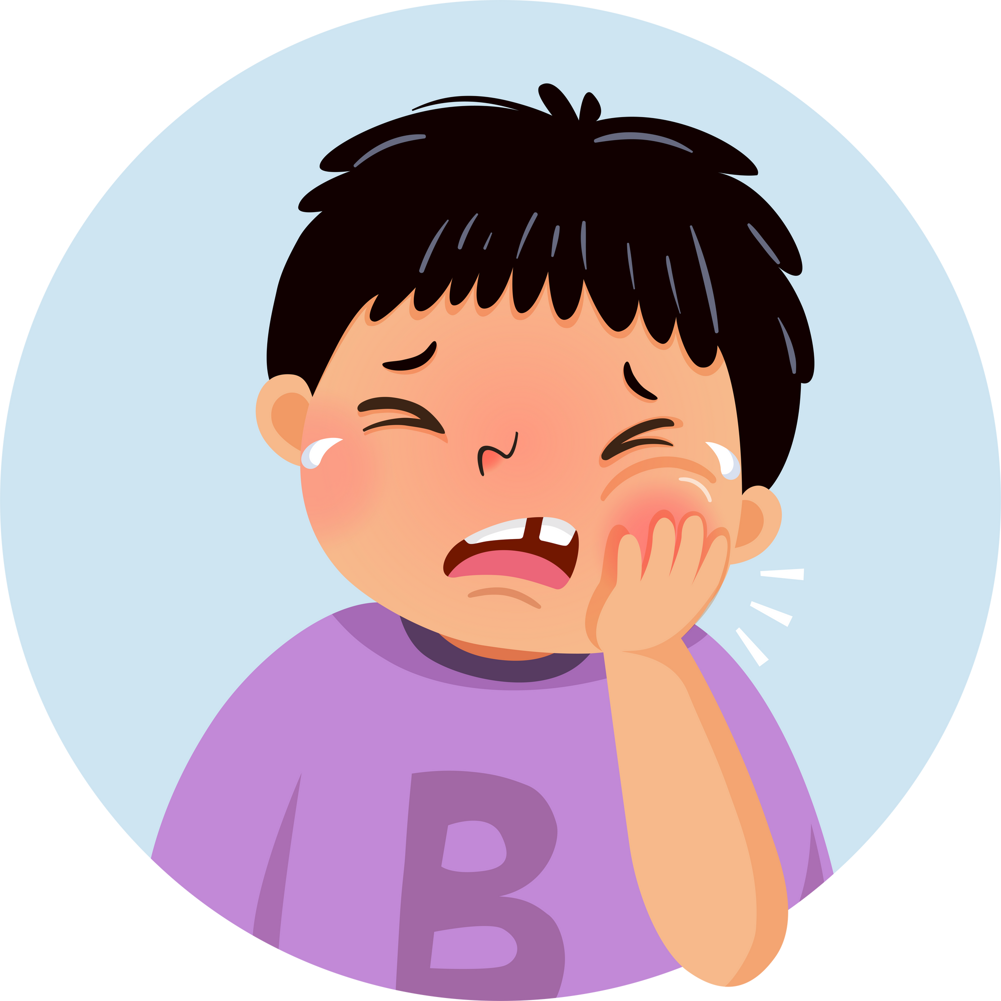

Question
  I have a toothache.
You have 5 seconds.

Slide 43

Answer
Yes

Slide 44
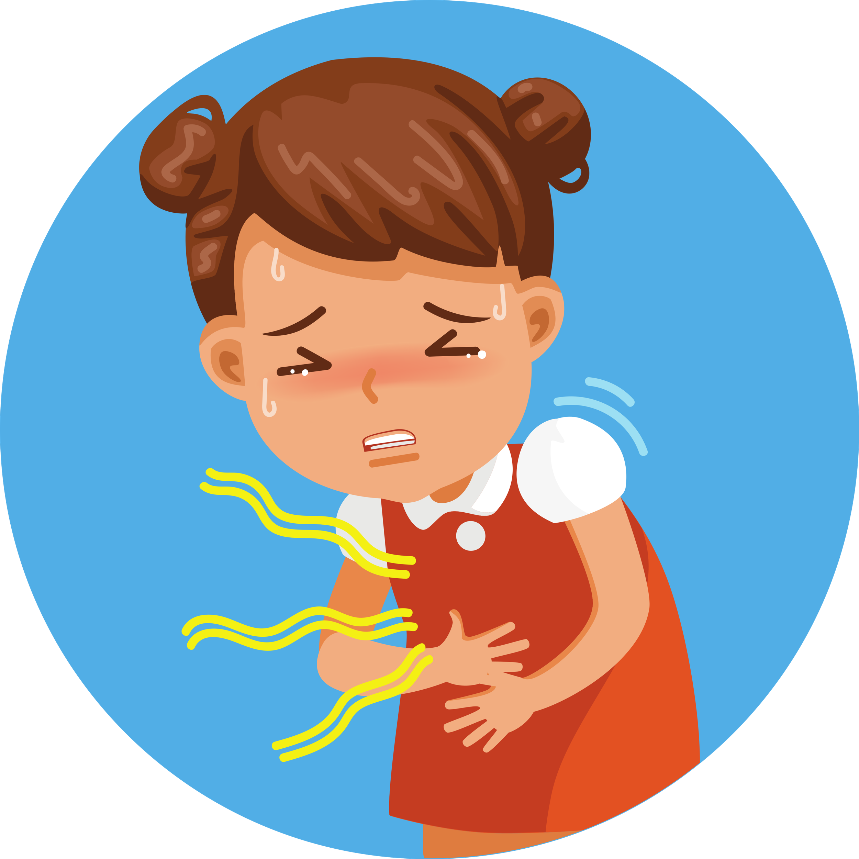
Question
  I have a headache.
You have 5 seconds.

Slide 45
Answer
No
I have a stomach ache.

Slide 46
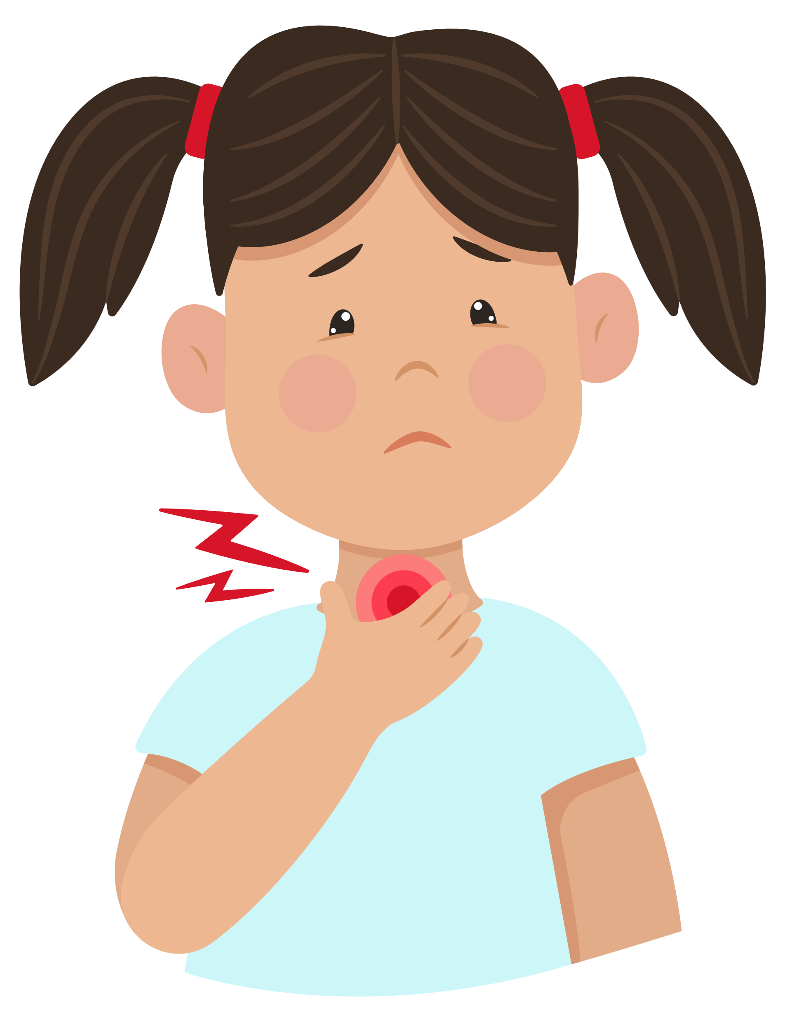
Question
  I have a sore throat.
You have 5 seconds.

Slide 47
Answer
Yes

Slide 48
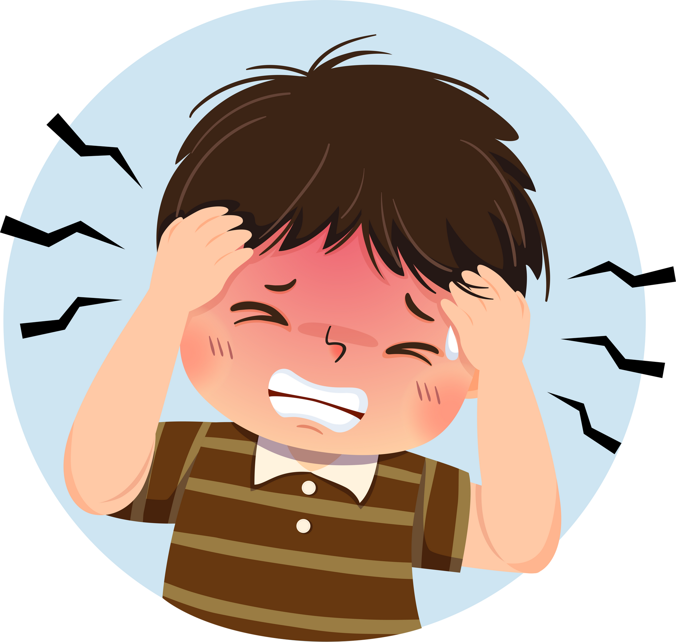
Question
  I am very well.
You have 5 seconds.

Slide 49
Answer
No
I have a headache.

Slide 50
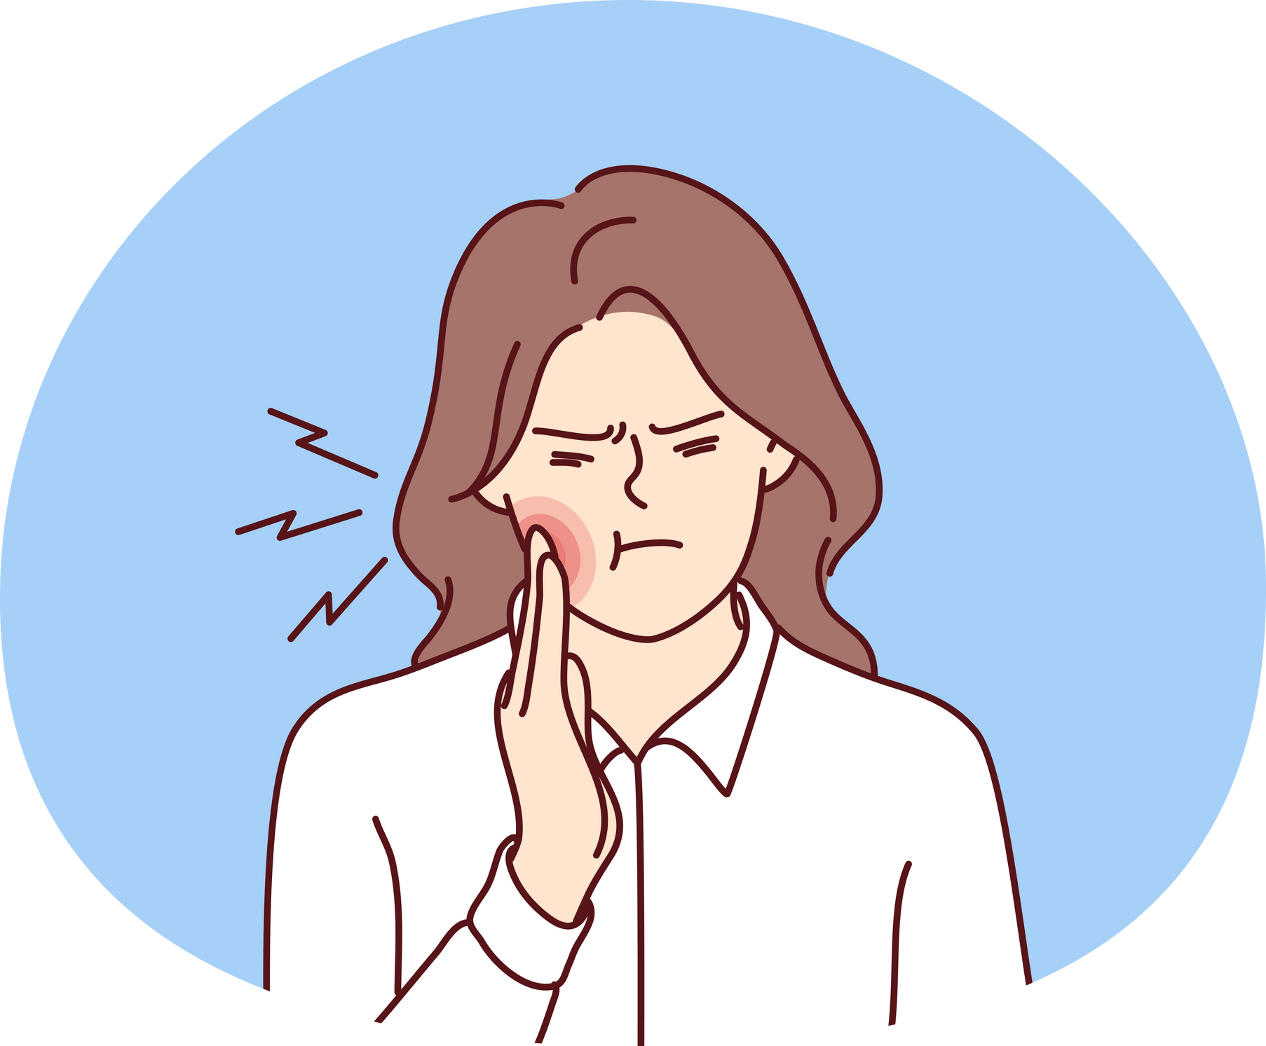
Question
  I have
  a stomach ache
You have 5 seconds.

Slide 51
Answer
No
I have a toothache.

